Slide 1
Software Design and Architecture
Lecture-13
Different Architectural Styles

Slide 2
Architectural Styles
Define a family of systems in terms of a pattern of its structural organization.
Define a vocabulary of components and connectors and a set of constraints on how they can be combined.

Slide 3
Architectural Styles
Pipe-and-Filter
Layered/Multi-tier
Client-Server
Event-driven
Parallel
State-Machine
Object-Oriented

Slide 4
Pipes-and-Filters Style Architecture

Slide 5
Pipes-and-Filters Style
Suitable for applications that require a defined series of independent computations to be performed on data.
Each component has a set of inputs and set of outputs.
A component reads a stream of data on its input and produces stream of data at its output.
The output is produced through a logical transformation to the input streams and computing incrementally, so that output begins before input is entirely consumed.
  This makes components act as Filters.
The connectors serve as channels for the streams, transmitting outputs of one filter to inputs of the other.
  This makes connectors act as Pipes.

Slide 6

Structure

Slide 7
Pipes & Filters
The filter transforms or filters the data it receives via the pipes with which it is connected. A filter can have any number of input pipes and any number of output pipes.
The pipe is the connector that passes data from one filter to the next. It is a directional stream of data, that is usually implemented by a data buffer to store all data, until the next filter has time to process it.
The pump or producer is the data source. It can be a static text file, or a keyboard input device, continuously creating new data.
The sink or consumer is the data target. It can be a another file, a database, or a computer screen.

Slide 8
Examples
DOS Commands: Provides a notation for accessing directories and files via pipes.
  C / new folder / abc
Traditional Compilers: Compilation phases are pipelined, though the phases are not always incremental. The phases in the pipeline include:
  lexical analysis + syntax analysis (parsing) + semantic analysis + code optimization + code generation

Slide 9
Architecture of a Compiler
Compilation is regarded as a sequential (pipeline) process.
Every phase is dependent on some data of the preceding phase.
text
Lex
Syn
Sem
Opt
CGen
code

Slide 10
Advantages
Easy to understand
  the overall input/output behavior of a system can be understood as a simple composition of the behaviors of the individual filters.
Support reuse
  any two filters can be hooked together, provided they agree on the data that is being transmitted between them.
Systems can be easily maintained and enhanced
  new filters can be added to existing systems and old filters can be replaced by improved ones.

Slide 11
Disadvantages
Not good choice for interactive systems, because of their transformational characteristic.

Slide 12
Layered Style Architecture

Slide 13
Layered Style
Organized hierarchically into layers.
Each layer provides service to the layer above it and serves as a client to the layer below.
The connectors are defined by the protocols that determine how the layers will interact.

Slide 14
Layered Style
Useful System
Basic Utilities
sets of
procedures
Core Layer
procedure
calls

Slide 15
Layered Architecture
Suitable for applications that involve distinct classes of services that can be organized hierarchically.
Components:
  are typically collections of procedures.
Connectors:
  are typically procedure calls.

Slide 16
Specializations
Often exceptions are made to permit non-adjacent layers to communicate directly.
  This is usually done for efficiency reasons.

Slide 17
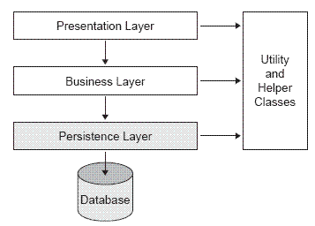
Example: Three-layered architecture

Slide 18
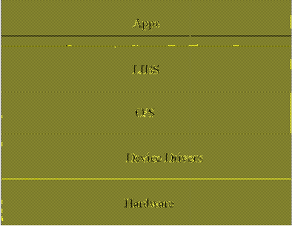
Example: Computer System

Slide 19
Advantages
Support designing the systems based on increasing levels of abstraction.
Support enhancement:
  Changes to the function of one layer affects at most two other layers.

Slide 20
Disadvantages
Not all systems are easily structured in a layered fashion.
Performance requirements may force the coupling of high-level functions to their lower-level implementations.

Slide 21
Event-based, Implicit Invocation Style

Slide 22
Event-based, Implicit Invocation Style
Suitable for applications that involve loosely-coupled collection of components, each of which carries out some operation and may in the process enable other operations.
Particularly useful for applications that must be reconfigured “on the fly”:
  Changing a service provider.
  Enabling or disabling capabilities.

Slide 23
Motivation
Systems whose components interfaces provide a collection of procedures, their components interact with each other by explicitly invoking the procedures.
We can avoid this explicit invocation.

Slide 24
Implicit Invocation Style
Instead of invoking a procedure directly
  A component can announce (or broadcast) one or more events.
  Other components in the system can register an interest in an event by associating a procedure with the event.
  When an event is announced, the broadcasting system (connector) itself invokes all of the procedures that have been registered for the event.

Slide 25
Implicit Invocation Style
An event announcement “implicitly” causes the invocation of procedures in other modules.
procedure
procedure
procedure
Announce event
Register interest in an event
Implicit invocation
Broadcasting System

Slide 26
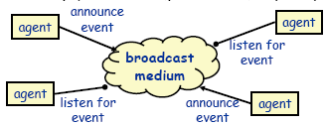
Based on Observer pattern
Basically, components communicate using a generalized Observer Design Pattern style of communication.

Slide 27
Components
  Modules whose interfaces provide a collection of procedures/methods and a set of events that it may announce
Connectors
  Bindings between event announcements and procedure/method calls

Slide 28
Examples
Used in programming environments to integrate tools:
  Debugger stops at a breakpoint and makes that announcement.
  Editor responds to the announcement by scrolling to the appropriate source line of the program and highlighting that line.

Slide 29
Examples
Used to enforce integrity constraints in database management systems (called triggers).
Used in user interfaces to separate the presentation of data from the applications that manage that data.

Slide 30
Advantages
Provides strong support for reuse since any component can be introduced into a system simply by registering it for the events of that system.
Eases system evolution since components may be replaced by other components without affecting the interfaces of other components in the system.

Slide 31
Disadvantages
When a component announces an event:
  it has no idea how other components will respond to it,
  it cannot rely on the order in which the responses are invoked
  it cannot know when responses are finished

Slide 32
Client Server Architectural
Style

Slide 33
Client Server Architectural Style
Client/server architecture illustrates the relationship between two computer programs in which one program is a client, and the other is Server.
Client makes a service request to server.
Server provides service to the request.

Slide 34
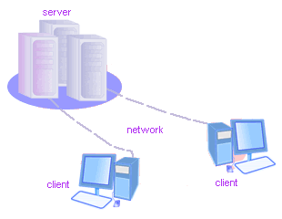
Client/Server
Although the client/server architecture can be used within a single computer by programs, but it is a more important idea in a network.
In a network, the client/server architecture allows efficient way to interconnect programs that are distributed efficiently across different locations.

Slide 35
Client-Server Style
Suitable for applications that involve distributed data and processing across a range of components.
Components:
  Servers: Stand-alone components that provide specific services such as printing, data management, etc.
  Clients: Components that call on the services provided by servers.
Connector: The network, which allows clients to access remote servers.

Slide 36
Client-Server Style
Client 1
Client 2
Client N
...
Network
File Server
Database Server
Object Server

Slide 37
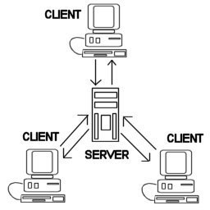
Common Example
The World Wide Web is an example of client-server architecture.
Each computer that uses a Web browser is a client, and the data on the various Web pages that those clients access is stored on multiple servers.

Slide 38
Another Example
If you have to check a bank account from your computer, you have to send a request to a server program at the bank.
That program processes the request and forwards the request to its own client program that sends a request to a database server at another bank computer to retrieve client balance information.
The balance is sent back to the bank data client, which in turn serves it back to your personal computer, which displays the information of balance on your computer.

Slide 39
Servers commonly contain data files and applications that can be accessed across the network, by workstations or user computers.
A user who wants to access data files, would use his or her client computer to access the data files on the server.

Slide 40
Example-1
File Servers:
  Primitive form of data service.
  Useful for sharing files across a network.
  The client passes requests for files over the network to the file server.

Slide 41
Example-2
Database Servers:
  More efficient use of distributing power than file servers.
  Client passes SQL requests as messages to the DB server; results are returned over the network to the client.
  Query processing done by the server.
  No need for large data transfers.

Slide 42
Advantages
Straightforward distribution of data.
Transparency of location.
Mix and match heterogeneous platforms
Easy to add new servers or upgrade existing servers.

Slide 43
Disadvantages
Performance of the system depends on the performance of the network.
Tricky to design and implement C/S systems.
Unless there is a central register of names and services, it may be hard to find out what services are available.

Slide 44
Suggested Readings
Software Architecture: Perspectives on an Emerging Discipline, Mary Shaw, David Garlan.
  Chapter-2

